Slide 1
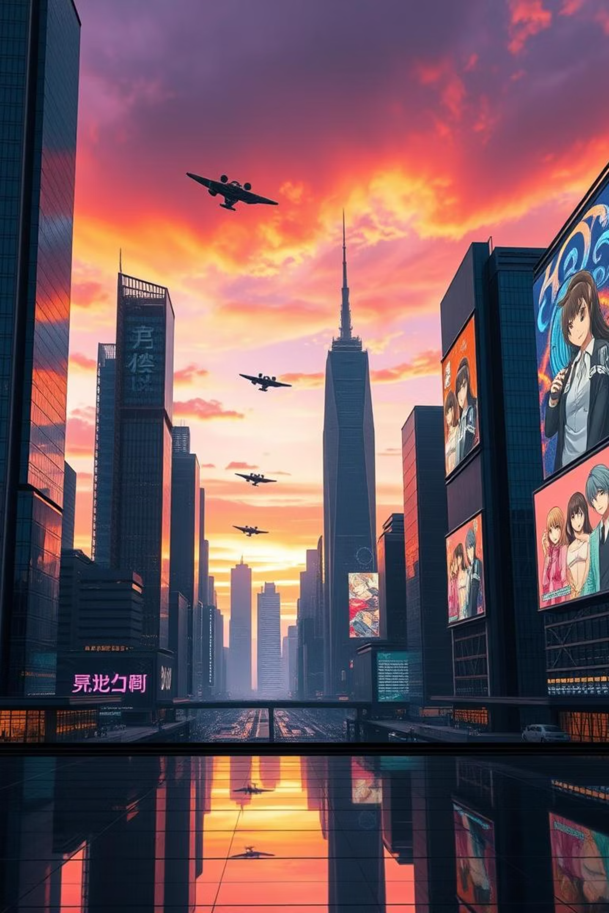
The Rise of Anime: From Niche to Global Phenomenon
Anime has transformed from a niche interest into a global cultural powerhouse. We will cover its origins and major milestones. We also delve into modern trends and challenges. The global market continues to expand rapidly.
By Khushwant Parihar

Slide 2

Early Seeds: Pre-War & Post-War Beginnings
1
1917: Early Animation
Japanese animators like Ōten Shimokawa experimented. "Namakura Gatana" showcased early techniques. These were short, experimental works.
2
Post-WWII: Tezuka's Revolution
Osamu Tezuka, "God of Manga," emerged. He revolutionized animation. His methods focused on cost-effectiveness. Disney heavily influenced his approach.
3
Limited Animation
Tezuka pioneered limited animation. This reduced frames and costs. It made TV series production feasible. This was crucial for anime's future.

Slide 3



Astro Boy & The Golden Age of TV Anime (1960s-1970s)
Astro Boy's Impact
Astro Boy (1963) was a groundbreaking series. It defined the 30-minute episode format. It also solidified limited animation use. This show set a new standard.
Genre Diversification
Western Introduction
The era saw rapid genre growth. Mecha anime like Mazinger Z (1972) emerged. Sports and slice-of-life genres also gained traction. This broadened anime's appeal.
Speed Racer (1967) introduced anime to Western audiences. It became a cultural phenomenon. This laid the groundwork for future global success.

Slide 4





Breaking Borders: The 1980s & 1990s Explosion
Akira's Redefinition
Akira (1988) set new cinematic standards. It explored mature themes. Its animation quality was revolutionary. It pushed anime's boundaries.
Ghost in the Shell
Ghost in the Shell (1995) influenced The Matrix. It popularized cyberpunk themes. This film showed anime's philosophical depth.
Studio Ghibli's Rise
Studio Ghibli formed in 1985. They released classics like My Neighbor Totoro (1988). Their films gained international acclaim.
Global Reach
Dragon Ball Z (1989) and Sailor Moon (1992) achieved massive global reach. These series became household names worldwide.

Slide 5

The Shadow of Piracy: A Double-Edged Sword
Early 2000s: Fan Subbing
Fan subbing groups emerged. They translated and distributed anime. This was often through torrent sites. It provided rapid global access.
Widespread Distribution
Piracy offered free, widespread distribution. It introduced anime to new audiences. However, it bypassed official channels.
Financial Losses
Industry Shift
Piracy led to significant revenue loss. Estimates suggest billions lost annually. This highlighted a major industry challenge.
The industry responded to piracy. Focus shifted to official streaming. This aimed to provide legal, accessible alternatives. It shaped modern distribution.

Slide 6
Pillars of Creativity: Iconic Anime Studios
Toei Animation
Dragon Ball, One Piece
Long-running series, iconic action
Sunrise
Gundam franchise, Code Geass
Mecha animation, complex narratives
MAPPA
Jujutsu Kaisen, Attack on Titan (Final Season)
Dynamic action, high energy
Kyoto Animation
Violet Evergarden, K-On!
Detailed character animation, quality focus
Ufotable
Demon Slayer
Stunning visual effects, high production

Slide 7








Studio Ghibli: Crafting Timeless Masterpieces
Founding Vision
Distinctive Themes
Founded in 1985. Hayao Miyazaki, Isao Takahata, and Toshio Suzuki led it. They aimed to create high-quality animated films.
Known for hand-drawn animation. Themes include nature and pacifism. Their films often explore environmental messages.
Enduring Artistic Vision
Spirited Away's Success
Ghibli is celebrated for universal stories. Their artistic vision is timeless. Films resonate with all ages and cultures.
Spirited Away (2001) won an Oscar. It was a global box office hit. This film set new records for Japanese cinema.

Slide 8
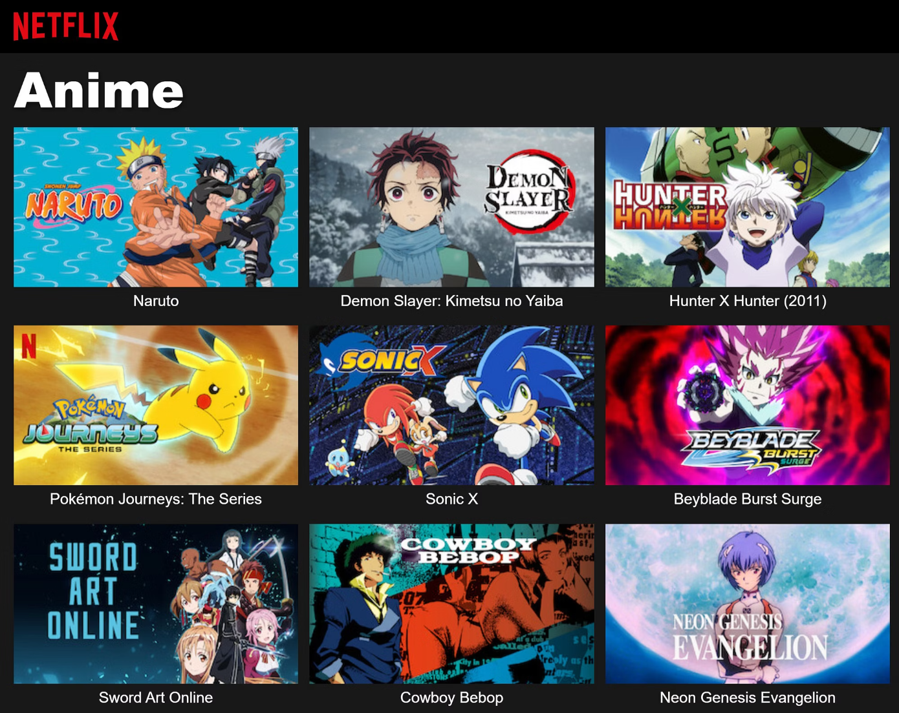
The Streaming Revolution & Global Reach (2010s-Present)
Streaming Pioneers
Crunchyroll (2006) led legal anime streaming. Sony later acquired it. This provided a legitimate platform for fans.
Netflix's Investment
Netflix invested over $1 billion in anime. They added hundreds of titles. This helped anime reach a broader audience.
$500M
100+
Demon Slayer Film
New Series Annually
The Demon Slayer: Mugen Train movie broke records. It grossed over $500 million globally. This showed anime's massive appeal.
Over 100 new anime series are produced annually. Anime is now a mainstream entertainment form. Its popularity continues to soar.

Slide 9





AI and Art: The Ghibli-Style Trend
AI Image Generators
Tools like DALL-E and Midjourney exist. They are trained on vast datasets. These can generate diverse art styles.
Ghibli-Style Art
AI can replicate Ghibli's distinctive style. It creates detailed, whimsical images. This showcases AI's artistic capabilities.
Ethical Debates
This trend sparked ethical concerns. Copyright, originality, and fair use are debated. It challenges traditional art creation.
Future of Animation
AI may integrate into animation workflows. It could assist artists. However, imitation worries persist in the creative community.

Slide 10
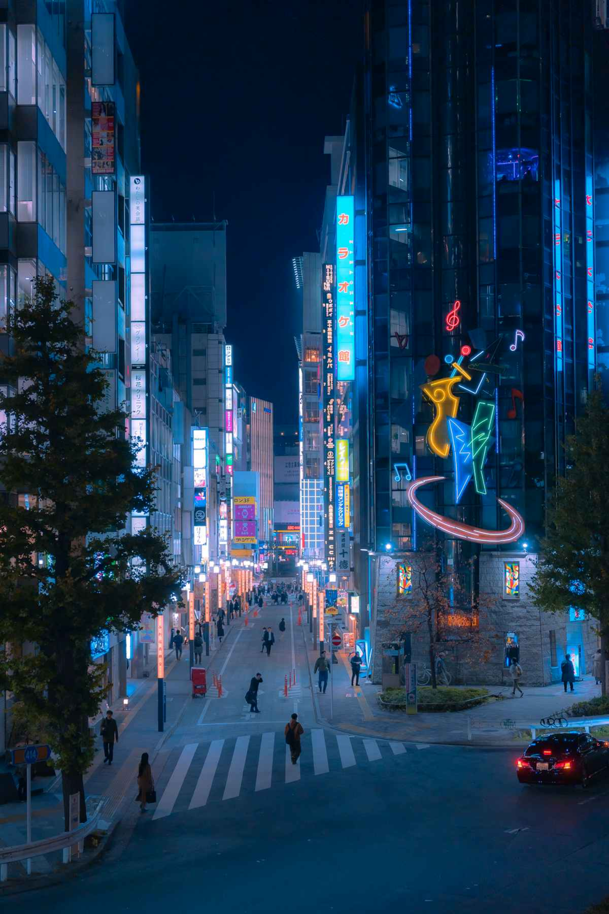




The Future of Anime: Innovation, Expansion, & Challenges
Global Expansion
Anime continues to expand globally. It reaches new markets. Increased international collaborations are expected.
Technological Integration
VR/AR and interactive experiences are emerging. AI-assisted animation tools will become more prevalent. Technology drives innovation.
Industry Challenges
Animator burnout is a critical issue. Intellectual property protection is crucial. Especially with AI's rise, challenges persist.
Cultural Significance
Anime remains a dynamic art form. Its cultural impact grows stronger. It continues to inspire and entertain worldwide.

